Slide 1


<Jared Price>
<3/28/2024>

Slide 2

Outline
Executive Summary
Introduction
Methodology
Results
Conclusion
Appendix

Slide 3
Executive Summary
Summary of methodologies
Data Collection via SpaceX API
Data Collection via Web Scraping
Data Wrangling
SQL Exploratory Data Analysis (EDA)
EDA with Visualization
Interactive Visual Analytics with Folium
Machine Learning Prediction
Summary of all results
Finalized Exploratory Data Analysis
Visual analytics summarized with screenshots
Data predictions

Slide 4
Introduction
Project background and context
In this project, we predicted whether or not the Falcon 9 first stage will land successfully. SpaceX advertises Falcon 9 rocket launches on its website with a cost of $62 million, while other providers cost upward of $165 million. Much of these savings are due SpaceX’s ability to reuse the first stage. Therefore, if we can determine if the first stage will land successfully, we can determine the cost of a launch. This information can then be used as leverage if an alternative company wants to bid against SpaceX for a rocket launch.
Questions to answer:
How can we determine if the rocket’s first stage will land successfully?
What relevant data can be extracted to determine these insights, and how can this data be used and visualized?
Are there certain factors, such as location or payload mass, that are more determinant of the success or failure of the launch?

Slide 5

Section 1

Slide 6
Methodology
Executive Summary
Data collection methodology:
Data was collected from SpaceX’s API and scraped from Wikipedia tables.
Perform data wrangling
Methods such as “one-hot encoding” and training label determination from categories.
Perform exploratory data analysis (EDA) using visualization and SQL
Perform interactive visual analytics using Folium and Plotly Dash
Perform predictive analysis using classification models
How to build, tune, evaluate classification models

Slide 7
Data Collection
Data was collected via the following methods:
API requests to SpaceX’s API
Web Scraping from Wikipedia tables regarding SpaceX launches
Data cleaning (removing missing values & replacing relevant values)
Exploratory analysis with SQL from CSV files

Slide 8
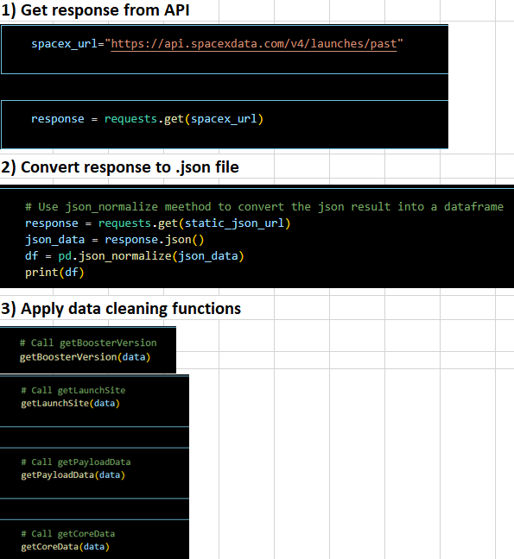
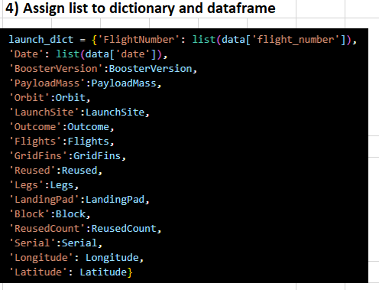
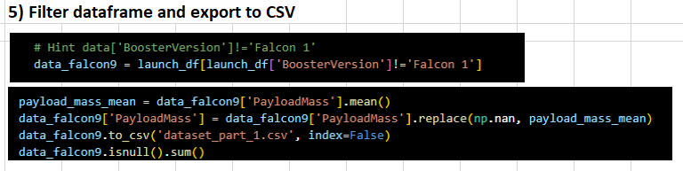
Data Collection – SpaceX API
https://github.com/puk82/IBM-Applied-Data-Science-Capstone-Project/blob/main/Week_1_Data_Collection_API_Lab.ipynb

Slide 9
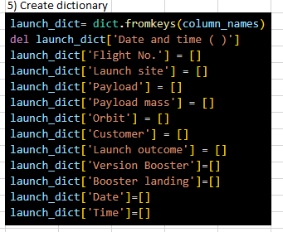
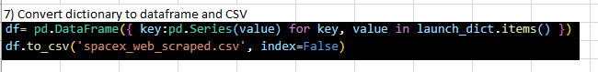
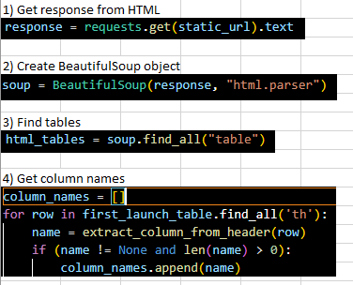
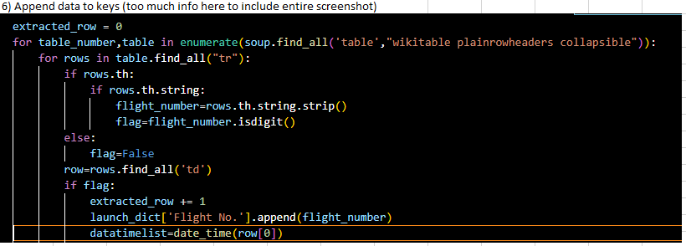
Data Collection - Scraping
https://github.com/puk82/IBM-Applied-Data-Science-Capstone-Project/blob/main/Week_1_Web_Scraping_Lab.ipynb

Slide 10
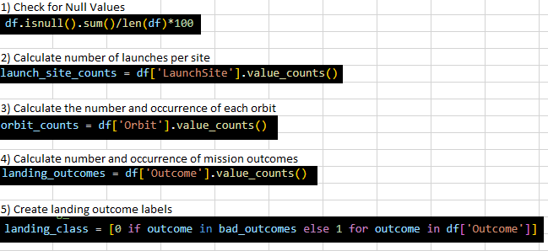
Data Wrangling
https://github.com/puk82/IBM-Applied-Data-Science-Capstone-Project/blob/main/Week_1_Data_Wrangling_Lab.ipynb

Slide 11
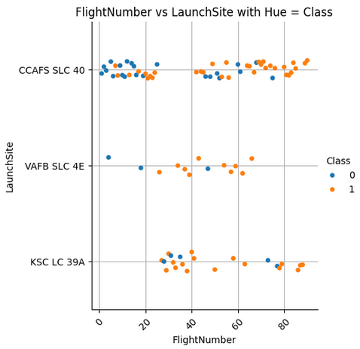
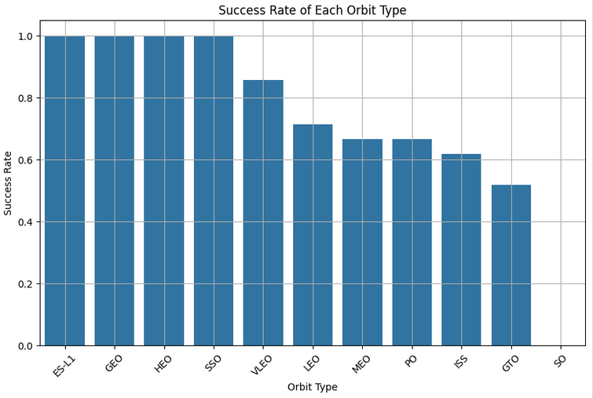
EDA with Data Visualization
Visualizations were made to compare factors such as Launch Site vs Payload Mass, Class vs Orbit, Flight Number vs Orbit, Payload Mass vs Orbit, Flight Number vs Launch Site, and Success Rate per Year.
https://github.com/puk82/IBM-Applied-Data-Science-Capstone-Project/blob/main/Week_2_Visualization_EDA_Lab.ipynb

Slide 12
EDA with SQL
SQL queries performed include:
Names of unique launch sites
5 records where launch sites begin with ‘CCA’
Total payload mass of boosters launched by NASA(CRS)
Average payload mass by booster
Date of first successful landing outcome in ground pad
Names of boosters with success in drone ship, and mass between 4000-6000 KG
Total number of successful and failure mission outcomes
Names of booster versions that have carried the max payload
Month names, failure landing outcomes in drone ships ,booster versions, and launch sites for the months in year 2015
The count of landing outcomes between 2010-06-04 and 2017-03-20 in descending order
https://github.com/puk82/IBM-Applied-Data-Science-Capstone-Project/blob/main/Week_2_SQL_EDA_Lab.ipynb

Slide 13
Build an Interactive Map with Folium
Launch sites were marked on the map with markers, circles, and lines to mark the success or failure of the launches for each site on a folium map.
Launch outcomes were also assigned.
These markers enabled identification of launch sites with high and low success rates, thus finding the optimal launch sites.
https://github.com/puk82/IBM-Applied-Data-Science-Capstone-Project/blob/main/Week_3_Folium_Interactive_Visual_Analytics_Lab.ipynb

Slide 14
Build a Dashboard with Plotly Dash
We used Plotly Dash to build an interactive dashboard displaying statistics such as total successes per site, total launches, payload mass vs. outcome, and different booster versions.
This interactive dashboard illustrates these statistics in a user-friendly manner for anyone to observe easily.
https://github.com/puk82/IBM-Applied-Data-Science-Capstone-Project/blob/main/Week_3_Plotly_Interactive_Dash.py

Slide 15
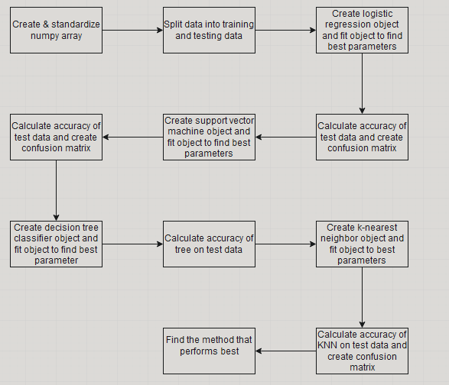
Predictive Analysis (Classification)
Data was loaded with numpy & pandas to be transformed and split.
GridSearchCV was used to tune hyperparameters, and accuracy was used to improve the model in order to find best performing classification model.
https://github.com/puk82/IBM-Applied-Data-Science-Capstone-Project/blob/main/Week_4_Machine_Learning_Prediction_Lab.ipynb

Slide 16
Results
For best results in prediction accuracy, SVM, KNN and logistic regression models should be used.
Heavier payloads fail more often than lighter payloads.
According to yearly analysis, success rates are regularly improving over time.
The most successful Launch Site is KSC LC 39A.

Slide 17

Section 2

Slide 18

Flight Number vs. Launch Site
There are far more launches from CCAFS SLC 40 than the other two sites.

Slide 19
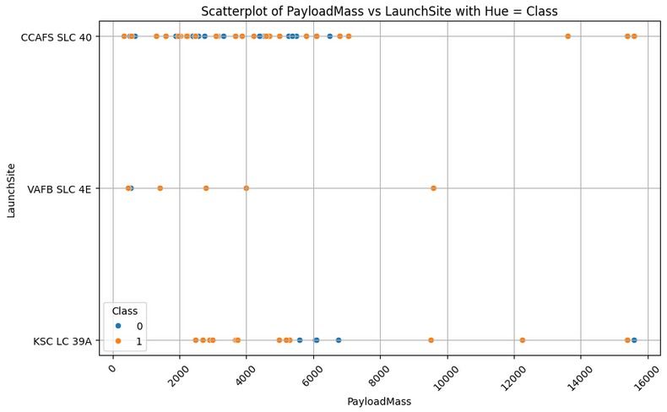
Payload vs. Launch Site
Lighter payloads tend to succeed more often.

Slide 20
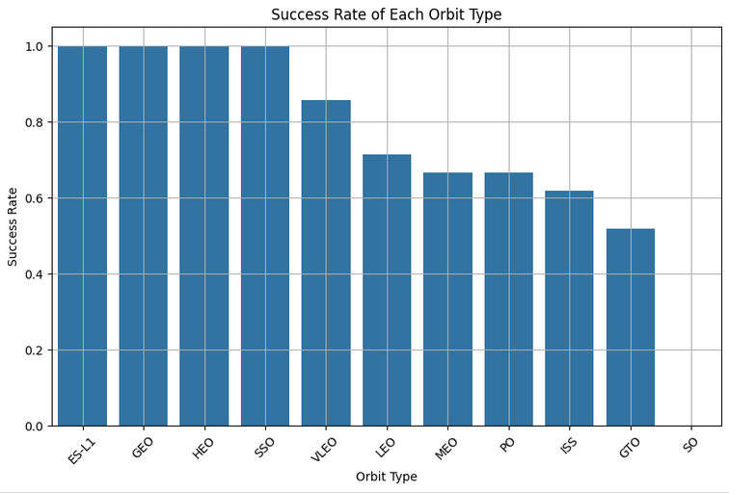
Success Rate vs. Orbit Type
Highest success rates include ES-L1, GEO, HEO, and SSO.

Slide 21
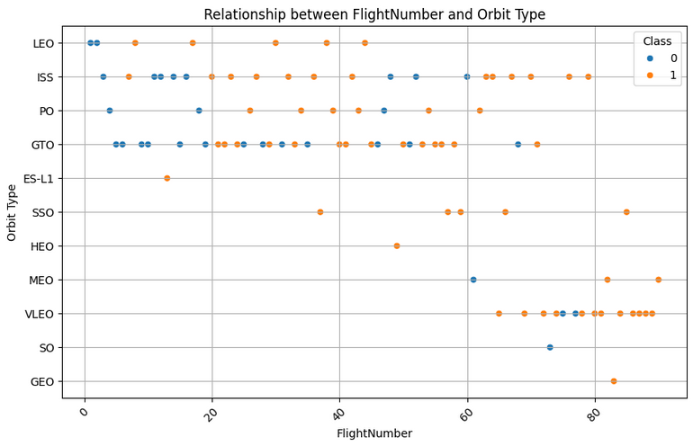
Flight Number vs. Orbit Type
LEO, ISS, PO and GTO orbit types correspond to older launches, whereas the more recent launches tend to be VLEO orbit types.

Slide 22
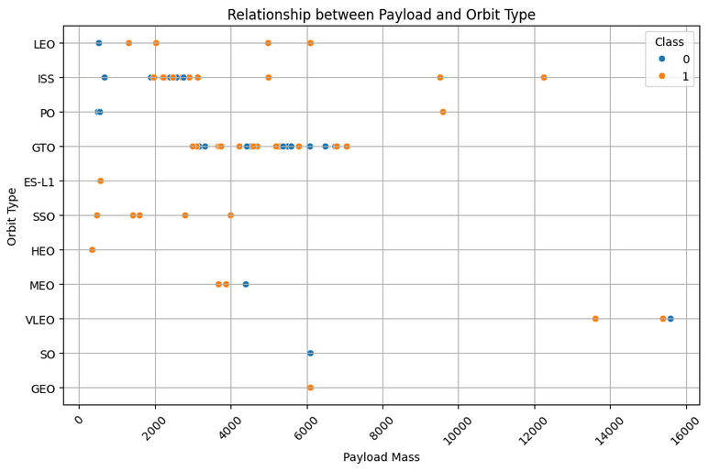
Payload vs. Orbit Type
Certain orbit types correspond strongly with certain payload mass ranges, such as ISS between 2000-4000 and GTO between 2000-8000.

Slide 23
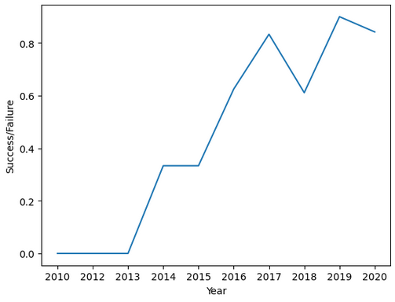
Launch Success Yearly Trend
Success rates seem to be largely increasing per year with some exceptions in 2018 and 2020.

Slide 24
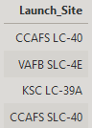
All Launch Site Names
Four different unique launch sites.

Slide 25
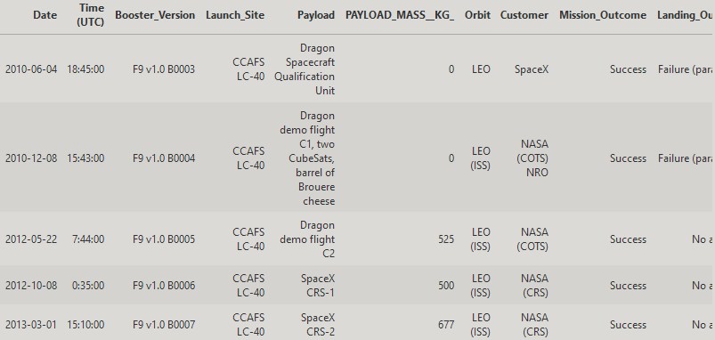
Launch Site Names Begin with 'CCA'
Find 5 records between 2010 and 2013where launch sites begin with `CCA`

Slide 26
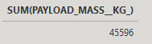
Total Payload Mass
Calculate the total payload carried by boosters from NASA

Slide 27
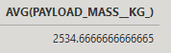
Average Payload Mass by F9 v1.1
Calculate the average payload mass carried by booster version F9 v1.1

Slide 28
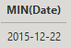
First Successful Ground Landing Date
Find the dates of the first successful landing outcome on ground pad

Slide 29
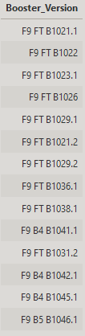
Successful Drone Ship Landing with Payload between 4000 and 6000
List the names of boosters which have successfully landed on drone ship and had payload mass greater than 4000 but less than 6000

Slide 30
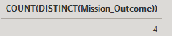
Total Number of Successful and Failure Mission Outcomes
Calculate the total number of successful and failure mission outcomes
Number of outcomes as distinct (unique)

Slide 31
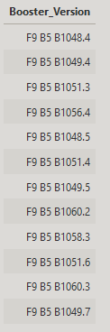
Boosters Carried Maximum Payload
List the names of the booster which have carried the maximum payload mass

Slide 32
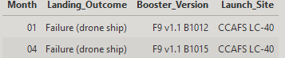
2015 Launch Records
List the failed landing_outcomes in drone ship, their booster versions, and launch site names for in year 2015

Slide 33
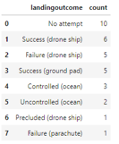
Rank Landing Outcomes Between 2010-06-04 and 2017-03-20
Rank the count of landing outcomes (such as Failure (drone ship) or Success (ground pad)) between the date 2010-06-04 and 2017-03-20, in descending order

Slide 34

Section 3

Slide 35
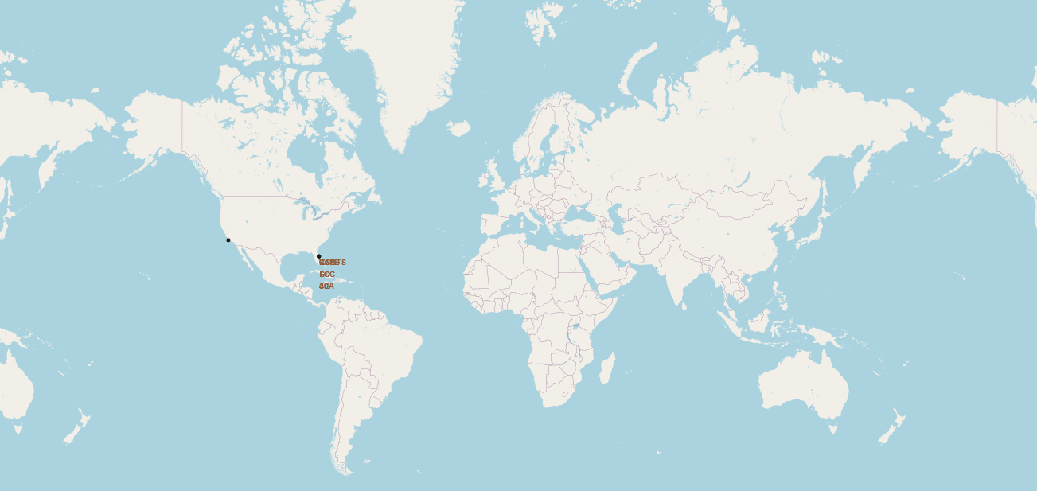
Global Map launch site location markers
SpaceX launch sites on East and West coasts of USA

Slide 36
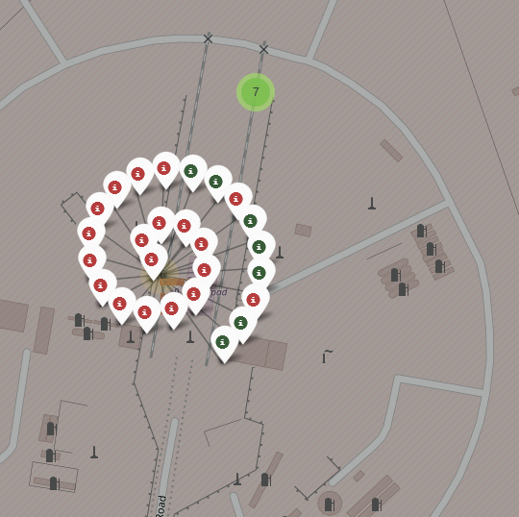
Colored launch outcomes
One example of launch site outcomes. Green is success and red is failure.

Slide 37
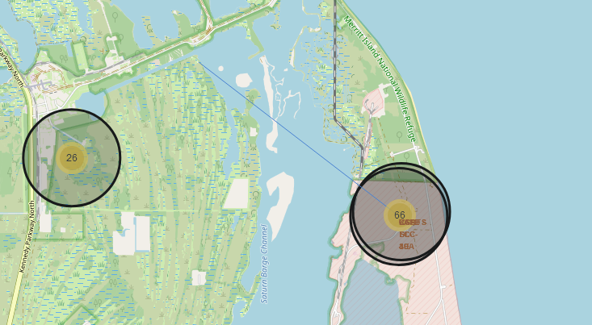
Launch site proximities
Proximity to coastline point illustrated with blue line.

Slide 38

Section 4

Slide 39
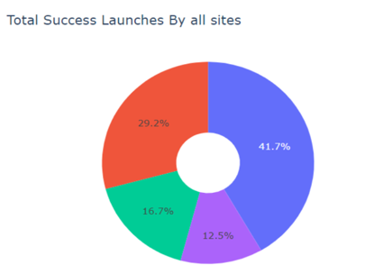
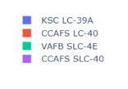
Launch Site success rates
A pie chart explaining different success rates of launches from launch sites.

Slide 40
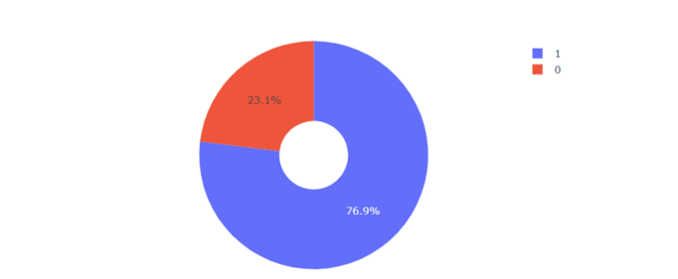
KSC LC-39A Success Rate
KSC LC-39A has a 76.9% successful launch rate, where 1 is success and 0 is failure.

Slide 41
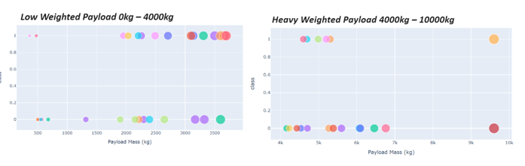
Payload Weight vs Success Rate
Payloads with lower weight succeed more often than heavier payloads.

Slide 42

Section 5

Slide 43
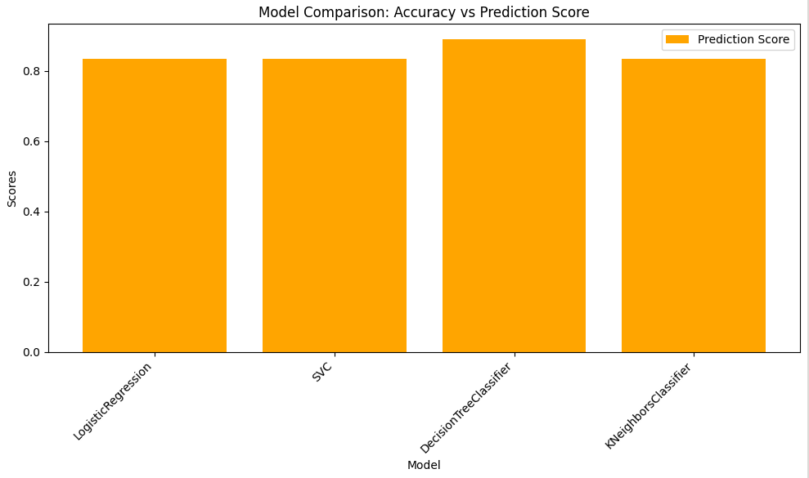
Classification Accuracy
The DecisionTreeClassifier has the highest prediction score.

Slide 44
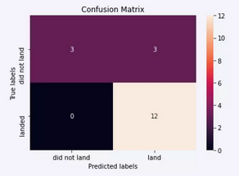
Confusion Matrix
The false positives of the Decision Tree Classifier confusion matrix are the largest category, meaning unsuccessful landings were marked as successful.

Slide 45
Conclusions
In conclusion, low weighted payloads perform better than heavier payloads overall.
Launch success rates are showing an increasing trend per year.
Orbits ES-L1, GEO, HEO, SSO and VLEO show the highest success rates.
KSC LC 39A was the most successful launch across all sites.
We can predict via Decision Tree Classifier that these launches will only get more successful with time.

Slide 46


